Slide 1
Insufficienza venosa cronica
Esperienze condivise tra università, ospedale e territorio
SALVARE LA SAFENA
Perche? Come?
Un problema medico, etico e legale
Claude Franceschi

Slide 2
A- La Grande Safena è il migliore materiale per eseguire by-pass periferici, particolarmente al di sotto del ginocchio
1-Meta-analysis of infrapopliteal angioplasty for chronic critical limb ischemia
Marcello Romiti, MD,a Maximiano Albers, MD,a Francisco Cardoso Brochado-Neto, MD,aAnai Espinelli S. Durazzo, MD,b Carlos Alberto Bragança Pereira, PhD,c and Nelson De Luccia, MD,b ( J Vasc Surg 2008;47:975-81.)
2-Meta-analysis of popliteal-to-distal vein bypass grafts for critical ischemia Maximiano Albers, MD, PhD,a Marcello Romiti, MD, PhD,a Francisco Cardoso Brochado-Neto, MD, PhD,a Nelson De Luccia, MD, PhD,a and Carlos Alberto Bragança Pereira, PhD,b Santos and São Paulo,São Paulo, Brazil ( J Vasc Surg 2006;43:498-503.)

Slide 3
B- La Grande safena è uguale all’arteria mammaria per i by-pass aorto-coronarici.
1-No touch technique of saphenous vein harvesting: Is great graft patency rate provided?
Papakonstantinou NA1, Baikoussis NG2, Goudevenos J3, Papadopoulos G4, Apostolakis E5J Thorac Cardiovasc Surg. 2015 Oct;150(4):880-8. doi: 10.1016/j.jtcvs.2015.07.027. Epub 2015 Jul 15.
2-The no-touch saphenous vein for coronary artery bypass grafting maintains a patency, after 16 years, comparable to the left internal thoracic artery: A randomized trial.Samano N¹, Geijer H², Liden M², Fremes S³, Bodin L⁴, Souza D⁵. TRIAL REGISTRATION: ClinicalTrials.gov NCT01686100.Copyright © 2015 The American Association for Thoracic Surgery. Published by Elsevier Inc. All rights reserved.

Slide 4
B- La Grande safena è uguale all’arteria mammaria per i by-pass aorto-coronarici.
Novel no touch technique of saphenous vein harvesting: Is great graft patency rate provided?
Papakonstantinou NA1, Baikoussis NG2, Goudevenos J3, Papadopoulos G4, Apostolakis E5..Abstract Ann Card Anaesth. 2016 Jul-Sep;19(3):481-8. doi: 10.4103/0971-9784.185537
Coronary artery bypass grafting surgery effectively relieves signs and symptoms of myocardial ischemia. The left internal thoracic artery (LITA) graft is the gold standard having 90-95% patency rate at 10 years, whereas only 50% of saphenous vein (SV) grafts are patent at 10 years. However, there is a novel "no touch" technique in order to harvest an SV complete with its cushion of surrounding tissue, thus maintaining its endothelium-intact. Significantly superior short- and long-term graft patency rates comparable to LITA grafts can be achieved. Consequently, the SV may be revived as an important conduit in coronary artery bypass surgery.

Slide 5
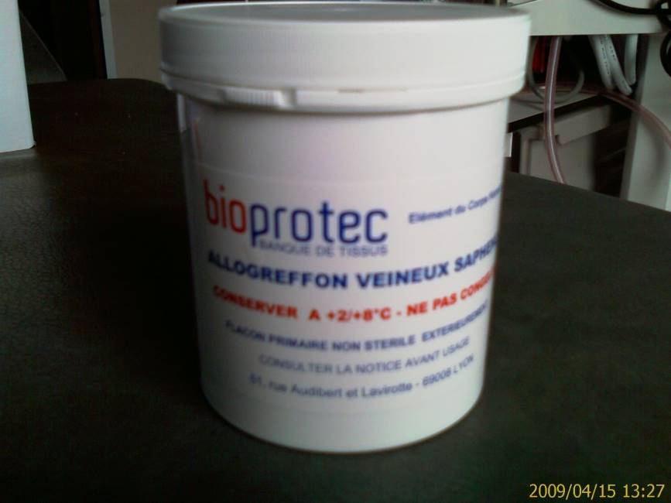
C- Le safene omologhe prelevate durante lo stripping danno risultati inferiori alle safene autologhe del paziente.
1-Outcomes of cold-stored venous allograft for below-knee bypasses in patients with critical limb ischemia. Ziza V¹, Canaud L², Gandet T³, Molinari N⁴, Alonso W³, Chastan R³, Branchereau P³, Picard E³. J Vasc Surg. 2015 Oct;62(4):974-83. doi: 10.1016/j.jvs.2015.04.437. Epub 2015 Jul 2.
2-Fondée en 1989, Bioprotec a permis de fédérer sur le territoire français les activités de recueil de veines saphènes lors du stripping des varices. « Les Allogreffons veineux Bioprotec sont pris en charge en sus des GHS pour
les établissements privés et publics. Le tarif est de 1480.00 euros HT et de 1561.40 euros TTC

Slide 6
Terapia delle varici
Scelta terapeutica:
Fatta dal paziente dopo un informazione chiara e completa, conformemente alla legge di Ippocrate.

Slide 7
INFORMAZIONE: Le terapie attuali
Le Varici sono una malattia benigna:
Terapie attuali:
1- Consigli igienico-dieteici e/o
2-Compressione elastica e/o
3- Procedure demolitive: Stripping e/o procedure endo-venose
4- Procedure conservative:
ASVAL: fattibile in casi limitati.
CHIVA: fattibile in ogni caso
5-Le safene possono essere necessarie e possono salvare la vita in caso di by-pass arterioso futuro

Slide 8
INFORMAZIONE: cura CHIVA
La CHIVA è una cura Conservativa ed Emodinamica dell’Insufficienza Venosa in Ambulatorio
E’ una chirurgia mini-invasiva sotto anestesia locale ed ambulatoriale
Superiore in tutti gli aspetti ai metodi demolitivi chirugichi, come quelli endovenosi, seconde le EBM (Evidence Based Medicine)

Slide 9
INFORMAZIONE: cura CHIVA secondo le EBM
Superiore sia ai metodi demolitivi chirugici,
che a quelli endovenosi, sotto tutti gli aspetti:
Dolore, Estetica, Recidive, Costo e Safena conservata.
MA richiede una
conoscenza approfondita dei nuovi concetti dell’emodinamica venosa
dell’indagine Ecocolordoppler
delle tecniche operatorie

Slide 10
INFORMAZIONE: cura CHIVA secondo le EBM
CHIVA vs Stripping
4 RCT CHIVA vs STRIPPING 5 e 10 years follow up
Conclusione: Meno recidive, meno complicazioni.
1 ]Carandina S, Mari C, De Palma M, Marcellino MG,Cisno C, Legnaro A, et al.Varicose Vein Stripping vsHaemodynamic Correction (CHIVA): a long term randomised trial. European Journal of Vascular and Endovascular Surgery 2008;35(2):230–7 : Follow up 10 ans
[2] Parés JO, Juan J, Tellez R, Mata A, Moreno C, Quer FX,et l.Varicose vein surgery: stripping versus the CHIVA Method: a randomized controlled trial. Annals of Surgery 2010;251(4):624–31: Follow up 5 ans
[3] Iborra-Ortega E, Barjau-Urrea E, Vila-Coll R, Ballon-Carazas H, Cairols-Castellote MA. Comparative study oftwo surgical techniques in the treatment of varicose veins of the lower extremities: results after five years of followup. Angiología 2006; 58(6):459–68. Follow up 5 ans
[4] CHIVA vs STRIPPING . Follow up 10 ans. Publication en cours 2017 PUBBLICAZIONE 2017

Slide 11
INFORMAZIONE: cura CHIVA secondo le EBM
CHIVA vs Stripping
1 COCHRANE REVIEW
Bellmunt-Montoya S, Escribano JM, Dilme J, Martinez-Zapata MJ. CHIVA method for the treatment of chronic venous insufficiency. Cochrane Database of Systematic Reviews 2012 , Issue 2 . Art. No.: CD009648. DOI:10.1002/14651858.CD009648 .
Conclusione: Meno recidive, meno complicazioni.
AUCUNE ETUDE PUBLIEE DEFAVORABLE A CHIVA
Malgré les affirmations non référencées des opposants à CHIVA qui allègent des récidives importantes.

Slide 12
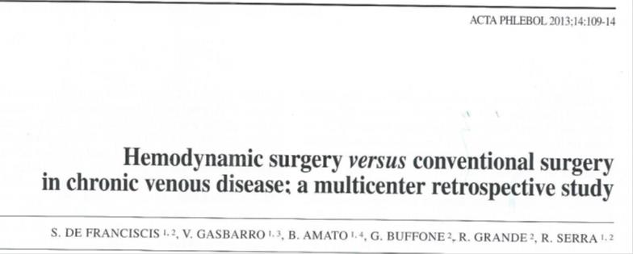
INFORMAZIONE: cura CHIVA secondo le EBM
CHIVA vs Stripping

Slide 13
CHIVA vs Stripping
CHIVA : A prospective study of a vein sparing technique for the
management of varicose vein disease
Marta Zmudzinski, BSc a, Pierre Malo, MD, FCSP b, Christine Hall, MD, FRCPC a, b,
Allen Hayashi, MD, FRCSC a, b, *a University of British Columbia, Faculty of Medicine,
The American Journal of Surgery 213 (2017) 967e969
Victoria, BC, Canada
Conclusion: Our results indicate that CHIVA appears to offer a promising alternative for the treatment of VVD (Varicose Vein Disease)

Slide 14
INFORMAZIONE: cura CHIVA secondo le EBM
CHIVA vs LASER
Chan, C.-Y.a , Chen, T.-C.b , Hsieh, Y.-K.a , Huang, J.-H.c
Retrospective comparison of clinical outcomes between endovenous laser and saphenous vein-sparing surgery for treatment of varicose veins (2011) World Journal of Surgery, 35 (7), pp. 1679-1686.
Conclusion:
CHIVA: Less post operation pains, less residual varices.

Slide 15
INFORMAZIONE: cura CHIVA secondo le EBM
CHIVA vs LASER and Stripping
Hemodynamic classification and CHIVA treatment of varicose veins in lower extremities (VVLE).
. Hua Wang1, Qianyi Chen1, Zhewei Fei1, Endong Zheng2, Zhanghui Yang2, Xiaowang Huang2 Int J Clin Exp Med 2016;9(2):2465-2471 www.ijcem.com /ISSN:1940-5901/IJCEM0016552.
1Department of Vascular Surgery, Xinhua Hospital Affiliated to Shanghai
Conclusion: CHIVA treatment has significant better curative effect than traditional surgery and endovenous therapy in the treatment of varicose veins. CHIVA treatment induced less damage, quicker health recovery, high safety factor and lower complications. Thus, CHIVA treatment can be widely used in clinical restoration than general minimally invasive operations.

Slide 16
Endo-venoso non è sinonimo di innocuo
International Angiology 2016 February;35(1):57-61
language: English
Morbidity and mortality after thermal venous ablations
Rafael D. MALGOR ¹, Antonios P. GASPARIS ², Nicos LABROPOULOS ² ✉
¹ Division of Vascular Surgery, The University of Oklahoma, Tulsa, OK, USA; ² Division of Vascular Surgery, Stony Brook University Medical Center, Stony Brook, NY, USA
CONCLUSION: EVA has gained high acceptance worldwide but the risks tend to be overlooked. Despite a very low complication rate, mortality has been reported. The complications found in MAUDE represent only a fraction as the majority of the practitioners are not aware of this database. Further investigation by a large national registry is warranted to better define the real magnitude of EVA complications.

Slide 17
CHIVA vs COMPRESSION in ULCERS
Minimally invasive surgical management of primary venous ulcers vs. compression treatment: a randomized clinical trial.. Zamboni Pand al A. EJ V E S. 2003
Conclusion:
much less recurrence after CHIVA

Slide 18
INFORMAZIONE: cura CHIVA secondo le EBM
GUIDE LINES
CHIVA, ASVAL and related techniques - Concepts and evidence
Alun Davis. Article in Phlebology 30(2 suppl):42-45 · November 2015
Conclusion: Classically, superficial venous insufficiency has been treated with the removal of the incompetent trunk, via open surgery or, increasingly, with endovenous interventions. Minimally invasive treatment modalities aiming to preserve the saphenous trunk, such as CHIVA and ASVAL, may also play an important role in the treatment of the patient with varicose vein

Slide 19
INFORMAZIONE: cura CHIVA secondo le EBM
GUIDE LINES
The care of patients with varicose veins and associated chronic venous diseases: Clinical practice guidelines of the Society for Vascular Surgery and the American Venous Forum. Peter Gloviczki, MD, and al. JVS 2011
Results with preservation of the saphenous vein. Results with CHIVA. Such techniques were better than compression in preventing ulcer recurrence188 and were at least equivalent to stripping of varicose veins.
CHIVA is a complex approach, and a high level of training and experience is needed to attain the results presented in this RCT.
It still requires considerable education of venous interventionists willing to learn this approach.

Slide 20
INFORMAZIONE: cura CHIVA secondo le EBM
GUIDE LINES
CHIVA Experts and Non Experts
Milone M, Salvatore G, Maietta P, Sosa Fernandez LM, Milone Recurrent varicose veins of the lower limbs after surgery. Role of surgical technique (stripping vs. CHIVA) and surgeon's experience.F. G Chir. 2011 Nov-Dec;32(11-12):460-3
CHIVA PERFORMED by experts is best than stripping , but less when performed by non experts.

Slide 21

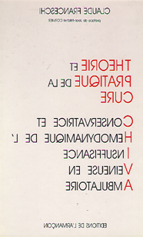
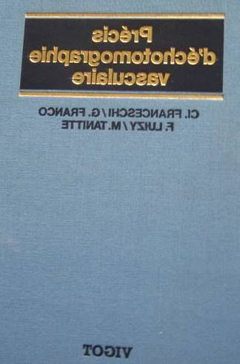
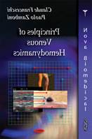
Affrontare le affermazioni:.
1- CHIVA is a complex approach, and a high level of training and experience is needed to attain the results presented in this RCT.
It still requires considerable education of venous interventionists willing to learn this approach (Glovici and al Guidelines)
2- CHIVA fatto da “esperti”, meglio dello stripping
3- Stripping meglio della CHIVA fatta da “non esperti”
( Milone M, Salvatore and al )
Non possono essere una scusa ma un incoraggiamento a apprendere per il meglio del paziente….e della professione.
BASTA STUDIARE…
Libri e Corsi da esperti

Slide 22
CONCLUSIONE 1
Secondo la EBM
Il by-pass safenico è sempre il gold standard della terapia delle arteriopatie.
La safena è conservabile con delle terapie non demolitive delle varici.
L’astenzione dalla cura CHIVA da risultati migliori delle cure demolitive.

Slide 23
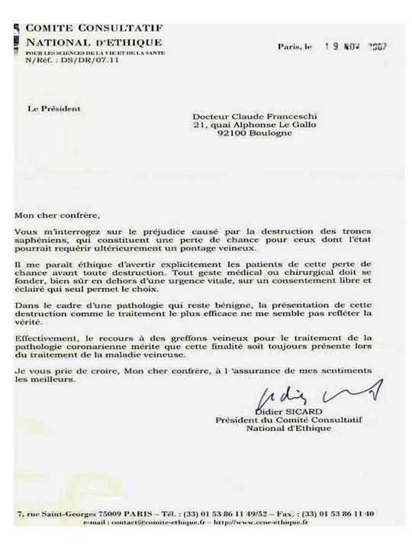
CONCLUSIONE 2
Secondo l’ETICA
.
Il consenso informato, deve riportare I dati EBM.

Slide 24
L'agnotologia è la scienza dell'ignoranza.
Studia come, ad esempio, per difendere i suoi interessi finanziari, l'industria del tabacco abbia diffuso un'affermazione contro-scientifica secondo cui il tabacco era innocuo.
Spiega anche perché a volte venga nascosta al pubblico :
la benignità delle vene varicose,
il pericolo di distruggere la vena safena per un possibile futuro vitale bypass arterioso,
le possibilità di cure non demolitive ed a basso costo come le Calze elastiche e CHIVA

Slide 25
Perché ?
Perchè non si utilizzano prodotti e macchine, come Stripper, Mousse, Laser e Radio-Frequenza,
Metodi tecnologicamente avanzati, ma osservano sempre il vecchio , facile ma scientificamente sbagliato concetto distruttivo invece che la…
CHIVA scientificamente più avanzata, richiede solo una conoscenza approfondita dell'emodinamica venosa e delle sue conseguenze fisiopatologiche, diagnostiche e terapeutiche.
https://www.franceculture.fr/emissions/voyage-en-agnotologie science-et-de-lignorance

Slide 26
CONCLUSIONE 3
BUONA NOTIZIA
La cura CHIVA e fattibile da chi s’impegna ad imparare e progredire nella sua professione.
Noi, cultori della Flebologia Emodinamica, non distruggiamo la Safena per evitare che ai nostri pazienti venga a mancare del materiale protesico naturale, quando dovranno essere sottoposti ad un by-pass coronarico o periferico

Slide 27
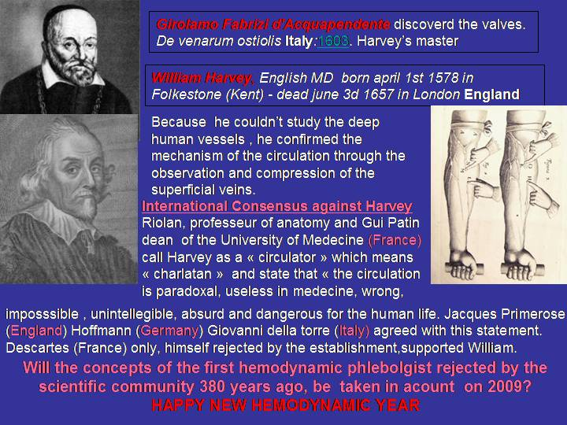




HARVEY ha scoperto la circolazione . Tutti i grandi medici e scienziati dell’Europa , tranne Descartes lo ritenevano incompetente, ciarlatano e pericoloso! Ancora, oggi, l’emodinamica non è sempre capita nè accettata.

Slide 28
Int Angiol. 2016 Feb;35(1):57-61. Epub 2015 Feb 12.
Morbidity and mortality after thermal venous ablations.
Malgor RD¹, Gasparis AP, Labropoulos N.
CONCLUSION:
EVA has gained high acceptance worldwide but the risks tend to be overlooked. Despite a very low complication rate, mortality has been reported. The complications found in MAUDE represent only a fraction as the majority of the practitioners are not aware of this database. Further investigation by a large national registry is warranted to better define the real magnitude of EVA complications.

Slide 29
Int Angiol. 2016 Feb;35(1):57-61. Epub 2015 Feb 12.
Morbidity and mortality after thermal venous ablations.
Malgor RD¹, Gasparis AP, Labropoulos N.
BACKGROUND:
The treatment of saphenous vein reflux has evolved over the years with the development of thermal ablation techniques. This study was designed to analyze the complications of endovenous ablation (EVA) using data from an open, voluntary national database.
METHODS:
We analyzed 349 adverse events of endovenous laser (EVLT) and radiofrequency ablation (RFA) reported in the Manufacturer and User Facility Device Experience (MAUDE) database from January 2000 to June 2012. Outcomes of interest were pulmonary embolism (PE), deep vein thrombosis (DVT), death, and device failures (i.e. broken laser tip, broken sheath).
RESULTS:
Two hundred and three (58%) reports were patient-related injuries and the other 146 (42%) device-related failures. More complications were related to RFA compared to EVLT (216 vs. 133 procedures). Thirty (8%) non-fatal PEs and 123 (35%) DVTs were described. There were 7 (2%) periprocedural deaths, all from PE. Of the 135 device failure reports, 41(30%) required surgical intervention. Despite an increasing number of procedures, reported events peaked around 2008 and stabilized since then. Over the past 5 years, the incidence of adverse events reported for EVLT and RFA were 1 and 2 per 10,000 procedures. The complication ratio over the years was <1:2500 for DVT, <1:10,000 for PE, <1:50,000 for death.
CONCLUSION:
EVA has gained high acceptance worldwide but the risks tend to be overlooked. Despite a very low complication rate, mortality has been reported. The complications found in MAUDE represent only a fraction as the majority of the practitioners are not aware of this database. Further investigation by a large national registry is warranted to better define the real magnitude of EVA complications.

Slide 30
LA DESTRUCTION DE LA GRANDE SAPHENE EST EVITABLE ET N’EMPECHE PAS UN BON TRATEMENT DES VARICES selon la MEDECINE BASEE SUR DES PREUVES (EBM)
LA GRANDE SAPHENE EST TOUJOURS LE MEILLEUR MARERIEL DE PONTAGE
A- La Saphène Interne ou Grande saphène est le meilleur matériel de pontage des artériopathies periphériques notamment au-dessous du genou.
1-Meta-analysis of infrapopliteal angioplasty for chronic critical limb ischemia
Marcello Romiti, MD,a Maximiano Albers, MD,a Francisco Cardoso Brochado-Neto, MD,aAnai Espinelli S. Durazzo, MD,b Carlos Alberto Bragança Pereira, PhD,c and Nelson De Luccia, MD,b ( J Vasc Surg 2008;47:975-81.)
2-Meta-analysis of popliteal-to-distal vein bypassgrafts for critical ischemia Maximiano Albers, MD, PhD,a Marcello Romiti, MD, PhD,a Francisco Cardoso Brochado-Neto, MD, PhD,a Nelson De Luccia, MD, PhD,a and Carlos Alberto Bragança Pereira, PhD,b Santos and São Paulo,São Paulo, Brazil ( J Vasc Surg 2006;43:498-503.)
B- La Saphène Interne ou Grande saphène est équivalente l’artère Mammaire Interne pour les pontages aorto-coronariens.
1-No touch technique of saphenous vein harvesting: Is great graft patency rate provided?
Papakonstantinou NA1, Baikoussis NG2, Goudevenos J3, Papadopoulos G4, Apostolakis E5J Thorac Cardiovasc Surg. 2015 Oct;150(4):880-8. doi: 10.1016/j.jtcvs.2015.07.027. Epub 2015 Jul 15.

Slide 31
2-The no-touch saphenous vein for coronary artery bypass grafting maintains a patency, after 16 years, comparable to the left internal thoracic artery: A randomized trial.Samano N¹, Geijer H², Liden M², Fremes S³, Bodin L⁴, Souza D⁵. TRIAL REGISTRATION:ClinicalTrials.gov NCT01686100.Copyright © 2015 The American Association for Thoracic Surgery. Published by Elsevier Inc. All rights reserved.
C- Les allogreffes saphène prélevées lors du stripping puis congelées donnent de moins bons resultats que les greffes autologues.
1-Outcomes of cold-stored venous allograft for below-knee bypasses in patients with critical limb ischemia. Ziza V¹, Canaud L², Gandet T³, Molinari N⁴, Alonso W³, Chastan R³, Branchereau P³, Picard E³. J Vasc Surg. 2015 Oct;62(4):974-83. doi: 10.1016/j.jvs.2015.04.437. Epub 2015 Jul 2.
2-Fondée en 1989, Bioprotec a permis de fédérer sur le territoire français les activités de recueil de veines saphènes lors du stripping des varices. « Les Allogreffons veineux Bioprotec sont pris en charge en sus des GHS pour
les établissements privés et publics. L e tarif est de 1480.00 euros HT et de 1561.40 euros TTC

Slide 32
LA GRANDE SAPHENE PEUT ETRE PRESEVEE ET LA MALADIE VERIQUEUSE EST CORRECTEMENT TRAITEE.
A- Les méthodes conservatrices comme la cure CHIVA , préservent le capital veineux et donnent 2 fois moins de récidives que le stripping et moins d’effets secondaires.
1-Revue CHOCRANE. CHIVA method for the treatment of chronic venous insufficiency.Bellmunt-Montoya S¹, Escribano JM, Dilme J, Martinez-Zapata MJ. Cochrane Database Syst Rev. 2015 Jun 29;(6):CD009648. doi: 10.1002/14651858.CD009648.pub3.
2-CHIVA: hemodynamic concept, strategy and results. Claude FRANCESCHI, Massimo CAPPELLI, Stefano ERMINI, Sergio GIANESINI, Erika MENDOZA, Fausto PASSARIELLO, Paolo ZAMBON. International Angiology 2016 February;35(1):8-30
B- Autres études :
1-« La cure CHIVA donne moins de douleurs post opératoires et est plus efficace que le Laser end-veineux ». -Retrospective comparison of clinical outcomes between endovenous laser and saphenous vein-sparing surgery for treatment of varicose veins (2011) World Journal of Surgery, 35 (7), pp. 1679-1686 Chan, C.-Y.a , Chen, T.-C.b , Hsieh, Y.-K.a , Huang, J.-H.c
2-« La cure CHIVA donne de meilleurs résultats que la chirurgie traditionnelle et les traitements endo-veineux avec moins d’effets secondaires, une récupération plus courte, plus de sécurité et moins de complication s. C’est pourquoi la cure CHIVA doit être préférée aux autres méthodes ». Hua Wang1, Qianyi Chen1, Zhewei Fei1, Endong Zheng2, Zhanghui Yang2, Xiaowang Huang2 Int J Clin Exp Med 2016;9(2):2465-2471 www.ijcem.com /ISSN:1940-5901/IJCEM0016552
1Department of Vascular Surgery, Xinhua Hospital Affiliated to Shanghai Jiaotong University School of Medicine Chongming Branch, Chongming 202150, China; 2Department of General Surgery, Cangnan People’s Hospital, Wenzhou 325800, Zhejiang, China.
3-Le taux de récidives après les procédures endo-veineuses est équivalent à celui du stripping, donc supérieurs à la cure CHIVA.

Slide 33
Pourquoi la cure CHIVA
Conservatrice et
Hémodynamique de l’
Insuffisance
Veineuse en
Ambulatoire

Slide 34
The patency of sequential and individual vein coronary bypass
grafts: a systematic review.
Li, J; Liu, Y; Zheng, J; Bai, T; Liu, Y; Wang, X; Liu, N; Cheng, L; Chen, Y; Zhang, H
Ann. Thorac. Surg. 92, 12920 (2011)
Department of Cardiac Surgery, Beijing Anzhen Hospital, Capital Medical University, Beijing,
China.
Abstract CONCLUSIONS: The midterm
and long-term patency of sequential vein grafts appears to be better than that of single vein grafts
and the patency of side-to-side anastomoses appears to be better than that of end-to-side
anastomoses for sequential vein grafts.

Slide 36
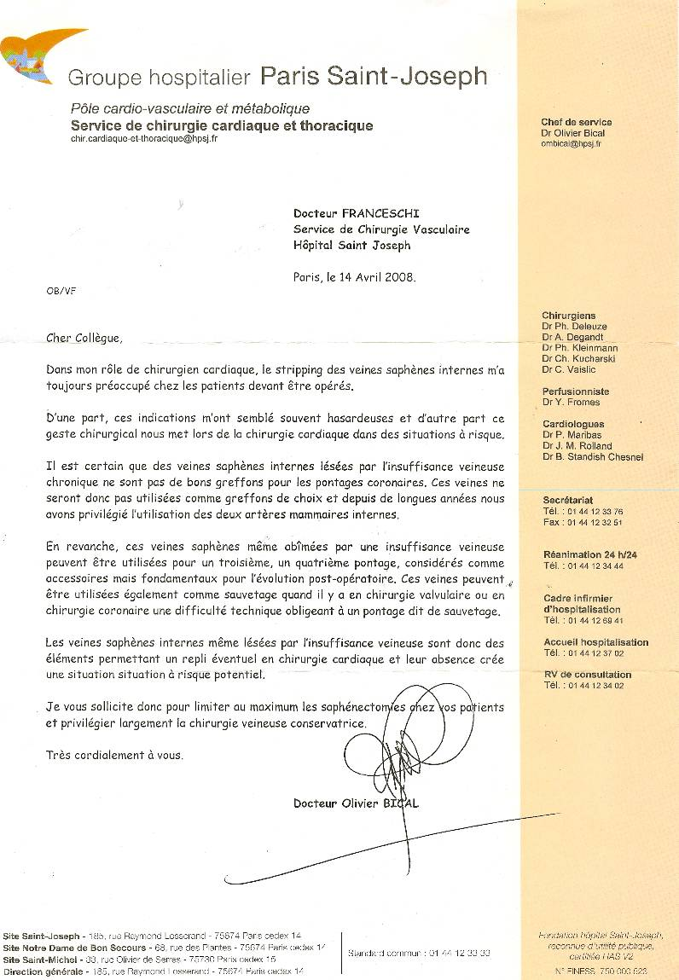

Slide 37
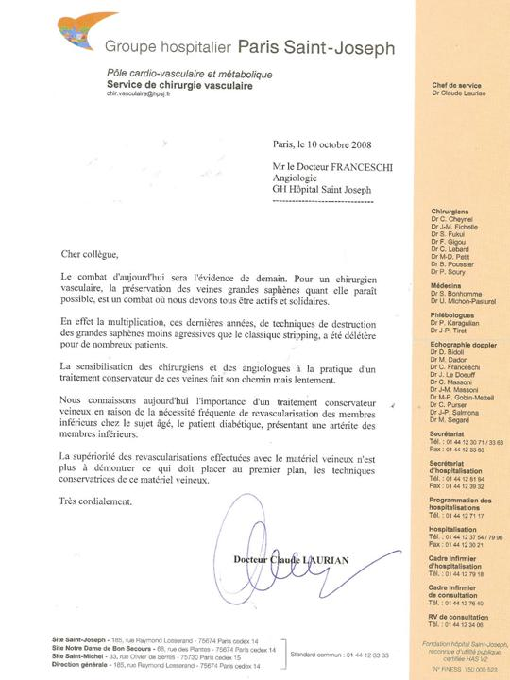

Slide 38
COMMENT APPRENDRE et PRATIQUER LA CHIVA
CHIVA: Hemodynamic concept, strategy and results
Article in International angiology: a journal of the International Union of Angiology 35(1) · June 2015
https://www.researchgate.net/publication/277778981_CHIVA_Hemodynamic_concept_strategy_and_results?ev=prf_pub
Une connaissance théorique de la physiopathologie hemodynamique veineuse
( qui n’a pas été enseigné aux chirurgiens, angiologues et phlébologues français ) , une connaissance de la méthode échodoppler spécifique ainsi que les techniques chirurgicales sous AL simples et rapides mais particulières car différentes de la chirurgie classique, sont indispensables au succès de la cure CHIVA.
La courbe d’apprentissage demande l’aide de collègues expérimentés.

Slide 39
Fondée en 1989, Bioprotec a permis de fédérer sur le territoire français
les activités de recueil de veines saphènes lors du stripping des varices,
d’assurer la production d’allogreffons veineux et leur cession
aux établissements demandeurs.
La cession d’allogreffons veineux est en constante augmentation,
passant de 286 en 2001 à 490 en 2006. crits
Les Allogreffons veineux Bioprotec sont inscrits
à la LPPR sous le N° 3333073. Ils sont pris en charge
en sus des GHS pour les établissements privés et publics.
Le tarif est de 1480.00 euros HT et de 1561.40 euros TTC.

Slide 40
GUIDELINES
The care of patients with varicose veins and associated chronic venous diseases: Clinical practice guidelines of the Society for Vascular Surgery and the American Venous Forum. Peter Gloviczki, MD, and al. JVS 2011
Results with preservation of the saphenous vein. Results with CHIVA. Such techniques were better than compression in preventing ulcer recurrence188 and were at least equivalent to stripping of varicose veins.
CHIVA is a complex approach, and a high level of training and experience is needed to attain the results presented in this RCT.
It still requires considerable education of venous interventionists willing to learn this approach.
CHIVA da”esperti” e “non esperti”
Milone M, Salvatore G, Maietta P, Sosa Fernandez LM, Milone Recurrent varicose veins of the lower limbs after surgery. Role of surgical technique (stripping vs. CHIVA) and surgeon's experience.F. G Chir. 2011 Nov-Dec;32(11-12):460-3
CHIVA fatto da “ESPERTI” meglio dello stripping,
Stripping meglio della CHIVA fatta da “NON ESPERTI”

Slide 41
RISPARMIARE LA SAFENA: VITALE!!!!
REVIEW 2014
OPTIMAL management of infrainguinal arterial occlusive disease
Authors: Pennywell DJ, Tan TW, Zhang WW
Full text: available on http://www.dovepress.com/article_18926.t34346121
Risk factors
Prevalence of 0.9% in people under age 50 and 23.2% in people over the age of 80.1
Autogenous vein is superior to synthetic graft as conduit for LEB,2,53–55 and the great saphenous vein (GSV) is superior to other autologous alternatives. An ideal vein conduit should be soft, compressible, at least 3 mm in diameter, and should not be calcified or sclerotic
Conclusion
Open infrainguinal GSV bypass remains the gold standard for revascularization in CLI, especially for patients at appropriate surgical risk and with suitable bypass conduit.

Slide 42
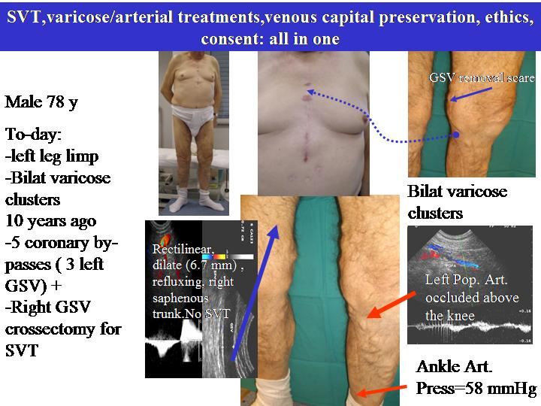

Slide 43
CHIVA, cura con meno rischi ed invasività: Un metodo particolare di legatura invece di Sezione della Crosse della Grande Safena
 | No. | Follow up months | S-F reflux recurrences | Symptomatic recurrences | Re-do surgery
TSFL | 82 | 17.5 | 6% | 0 | 0
CROSSOTOMY | 60 | 28.3 | 3.3% | 0 | 0
TRIPLE LIGATION | 47 | 12 | 42% | 14.4% | 3
Table 1
Veins and Lym^hatics | TITLE
Vol 3, No 1 (2014) | Multiple ligation of the proximal greater saphenous vein in the CHIVA treatment of primary varicose veins | ABSTRACT PDF
Roberto Delfrate, Massimo Bricchi, Claude Franceschi, Matteo Goldon

Slide 44
In corso: (OB) Chiva :
studio di una CHIVA modificata in termini di strategia e tattica basata sulla chiusura della crosse della Grande Safena con il LASER
The Office Based (OB) Chiva Protocol
Fausto Passariello and al.

Slide 45
Tutti gli studi da più 20 anni confermano
la validità dei nuovi concetti di fisiopatologia venosa che hanno fatto nascere la CHIVA
la superiorità della CHIVA in termini di risultati clinici
la giustificazione etica e professionale del risparmio della safena, per un possibile futuro by-pass che potrebbe salvare arti e vita del paziente

Slide 46
Pourquoi la cure CHIVA
Conservatrice et
Hémodynamique de l’
Insuffisance
Veineuse en
Ambulatoire

Slide 47
CHIVA’S STORY

Slide 48
3 RCT CHIVA vs STRIPPING 5 e 10 anni follow up
Moins de recidives, moins de complications
1 ]Carandina S, Mari C, De Palma M, Marcellino MG,Cisno C, Legnaro A, et al.Varicose Vein Stripping vsHaemodynamic Correction (CHIVA): a long term randomised trial. European Journal of Vascular and Endovascular Surgery 2008;35(2):230–7
[2] Parés JO, Juan J, Tellez R, Mata A, Moreno C, Quer FX,et l.Varicose vein surgery: stripping versus the CHIVA Method: a randomized controlled trial. Annals of Surgery 2010;251(4):624–31
[3] Iborra-Ortega E, Barjau-Urrea E, Vila-Coll R, Ballon-Carazas H, Cairols-Castellote MA. Comparative study oftwo surgical techniques in the treatment of varicose veins of the lower extremities: results after five years of followup. Angiología 2006; 58(6):459–68.

Slide 49
5 years follow up : Recurrence rate: CHIVA vs stripping
Stripp. Clinical
Stripp. Duplex guided
St -MC
CHIVA
St -ED
TC
Duplex Guided Vs Clinical : NO difference
Duplex is USLESS for stripping
5ans. 550 Patients

Slide 50
1 COCHRANE REVIEW
Meno recidive, meno complicanze
Bellmunt-Montoya S, Escribano JM, Dilme J, Martinez-Zapata MJ. CHIVA method for the treatment of chronic venous insufficiency. Cochrane Database of Systematic Reviews 2012 , Issue 2 . Art. No.: CD009648. DOI:10.1002/14651858.CD009648 .

Slide 51
Un nuovo RCT CHIVA vs STRIPPING a 10 anni follow up IN CORSO DI PUBBLICAZIONE 2017
Meno recidive, meno complicanze

Slide 52
EVIDENCES | Level | Grade
meta-analyses de RCT | Ia | A | Strong
Au moins un RCT | Ib
Au moins une étude clinique bien conduite sans randomisation | IIa | B | Mid
Au moins un autre type d’étude clinique bien programmé et quasi expérimental | IIb
Au moins un autre type d’étude clinique bien programmée et non expérimentale | III
Opinions de comités d’experts ou expérience d’autorités reconnues | IV | C | Weak
CHIVA (4 RCT)
CHIVA (4 RCT)
+ Cochrane Library REVIEW in progress
Other venous technics at this level????
Stripping still Gold standard? CHIVA ?

Slide 54
CHIVA vs LASER
Chan, C.-Y.a , Chen, T.-C.b , Hsieh, Y.-K.a , Huang, J.-H.c
Retrospective comparison of clinical outcomes between endovenous laser and saphenous vein-sparing surgery for treatment of varicose veins (2011) World Journal of Surgery, 35 (7), pp. 1679-1686.
Conclusion: CHIVA: Less post operation pains , less residual varices.

Slide 55
CHIVA vs LASER et STRIPPNG
-« La cure CHIVA donne de meilleurs résultats que la chirurgie traditionnelle et les traitements endo-veineux avec moins d’effets secondaires, une récupération plus courte, plus de sécurité et moins de complication s. C’est pourquoi la cure CHIVA doit être préférée aux autres méthodes ». Conclusion: CHIVA treatment has significant better curative effect than traditional surgery and endovenous therapy in the treatment of varicose veins. CHIVA treatment induced less damage, quicker health recovery, high safety factor and lower complications. Thus, CHIVA treatment can be widely used in clinical restoration than general minimally invasive operations. Keywords: Varicose veins, hemodynamic classification, CHIVA
. Hua Wang1, Qianyi Chen1, Zhewei Fei1, Endong Zheng2, Zhanghui Yang2, Xiaowang Huang2 Int J Clin Exp Med 2016;9(2):2465-2471 www.ijcem.com /ISSN:1940-5901/IJCEM0016552. Hemodynamic classification and CHIVA treatment of varicose veins in lower extremities (VVLE).
1Department of Vascular Surgery, Xinhua Hospital Affiliated to Shanghai Jiaotong University School of Medicine Chongming Branch, Chongming 202150, China; 2Department of General Surgery, Cangnan People’s Hospital, Wenzhou 325800, Zhejiang, China

Slide 56
International Angiology 2016 February;35(1):57-61
language: English
Morbidity and mortality after thermal venous ablations
Rafael D. MALGOR ¹, Antonios P. GASPARIS ², Nicos LABROPOULOS ² ✉
¹ Division of Vascular Surgery, The University of Oklahoma, Tulsa, OK, USA; ² Division of Vascular Surgery, Stony Brook University Medical Center, Stony Brook, NY, USA
CONCLUSION: EVA (Endo Vascular Ablation ) has gained high acceptance worldwide but the risks tend to be overlooked. Despite a very low complication rate, mortality has been reported. The complications found in MAUDE represent only a fraction as the majority of the practitioners are not aware of this database. Further investigation by a large national registry is warranted to better define the real magnitude of EVA complications.

Slide 57
CHIVA, ASVAL and related techniques - Concepts and evidence
Alun Davis. Article in Phlebology 30(2 suppl):42-45 · November 2015
Classically, superficial venous insufficiency has been treated with the removal of the incompetent trunk, via open surgery or, increasingly, with endovenous interventions. Minimally invasive treatment modalities aiming to preserve the saphenous trunk, such as CHIVA and ASVAL, may also play an important role in the treatment of the patient with varicose vein

Slide 58
CHIVA: Hemodynamic concept, strategy and results
Article in International angiology: a journal of the International Union of Angiology 35(1) · June 2015
https://www.researchgate.net/publication/277778981_CHIVA_Hemodynamic_concept_strategy_and_results?ev=prf_pub

Slide 59
Minimally Invasive Surgical management of primary venous Ulcer vs. Compression Treatment: a randomized Clinical Trial
P.Zamboni and all
Eur J vasc Endovasc Surg 00,1 6 (2003)

Slide 60
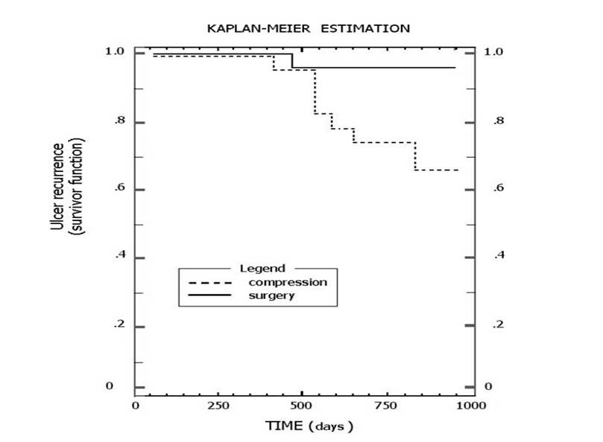
Minimally invasive surgical management of primary venous ulcers vs. compression treatment: a randomized clinical trial.. Zamboni Pand al A. EJ V E S. 2003
KAPLAN-MEIR ESTIMATION
1.0
1.0
CHIVA
0.8
0.8
0.6
compression
0.6
0.4
0.4
0.2
0.2
0
0
0
250
500
500
1000
750
TIME (days)
Notes:
Chap12 Fig 6 Ulcer recurrences a 3 years after CHIVA I or CHIVA I+II performed for venous ulcers, straight line, and by standard compression, interrupted line.

Slide 61
PRESERVER LA SAPHENE : VITAL!!!!
REVIEW 2014
OPTIMAL management of infrainguinal arterial occlusive disease
Authors: Pennywell DJ, Tan TW, Zhang WW
Full text: available on http://www.dovepress.com/article_18926.t34346121
Risk factors
Prevalence of 0.9% in people under age 50 and 23.2% in people over the age of 80.1
Autogenous vein is superior to synthetic graft as conduit for LEB,2,53–55 and the great saphenous vein (GSV) is superior to other autologous alternatives. An ideal vein conduit should be soft, compressible, at least 3 mm in diameter, and should not be calcified or sclerotic
Conclusion
Open infrainguinal GSV bypass remains the gold standard for revascularization in CLI, especially for patients at appropriate surgical risk and with suitable bypass conduit.

Slide 62
Fondée en 1989, Bioprotec a permis de fédérer sur le territoire français
les activités de recueil de veines saphènes lors du stripping des varices,
d’assurer la production d’allogreffons veineux et leur cession
aux établissements demandeurs.
La cession d’allogreffons veineux est en constante augmentation,
passant de 286 en 2001 à 490 en 2006. crits
Les Allogreffons veineux Bioprotec sont inscrits
à la LPPR sous le N° 3333073. Ils sont pris en charge
en sus des GHS pour les établissements privés et publics.
Le tarif est de 1480.00 euros HT et de 1561.40 euros TTC.

Slide 63
GUIDELINES
The care of patients with varicose veins and associated chronic venous diseases: Clinical practice guidelines of the Society for Vascular Surgery and the American Venous Forum. Peter Gloviczki, MD, and al. JVS 2011
Results with preservation of the saphenous vein. Results with CHIVA. Such techniques were better than compression in preventing ulcer recurrence188 and were at least equivalent to stripping of varicose veins.
CHIVA is a complex approach, and a high level of training and experience is needed to attain the results presented in this RCT.
It still requires considerable education of venous interventionists willing to learn this approach.
CHIVA Experts et Non Experts
Milone M, Salvatore G, Maietta P, Sosa Fernandez LM, Milone Recurrent varicose veins of the lower limbs after surgery. Role of surgical technique (stripping vs. CHIVA) and surgeon's experience.F. G Chir. 2011 Nov-Dec;32(11-12):460-3
CHIVA PERFORMED by experts is best than stripping , but less when performerd by non experts.

Slide 64
Conclusion:
LET’S LEARN OUR JOB!

Slide 65
English summary: Great saphenous trunks destruction for varices needs the clear informed consent of the patient and cannot be presented to him as the most effective method

Slide 67
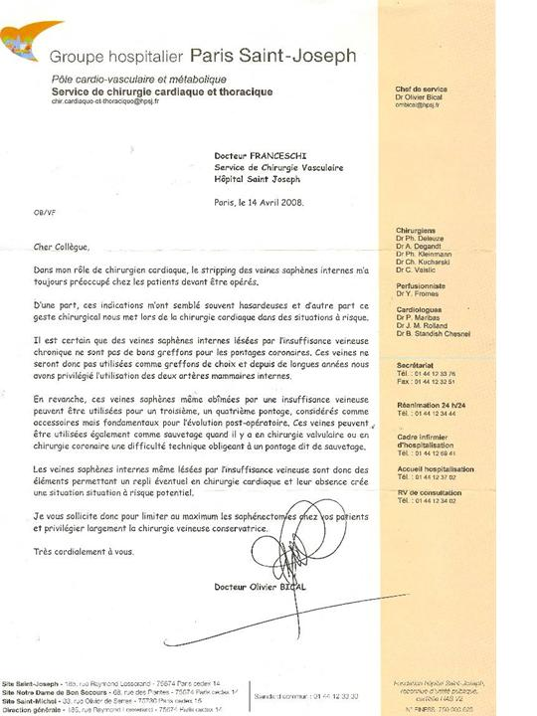

Slide 68
Combien d'amputations sur les membres inférieurs en France ?
Le diabète, quel que soit son type, expose à des complications vasculaires et neurologiques pouvant affecter les membres inférieurs et conduire dans les cas les plus graves à l'amputation. A l'échelon mondial, le diabète est ainsi la cause principale des amputations aux membres inférieurs (AMI) puisqu'il est à l'origine de plus de 50 % d'entre elles. En France, les données épidémiologiques sont, à cet égard très insuffisantes. Ceci a justifié le lancement en 2001 d'un programme de recherche qui a notamment permis de collecter des informations sur les AMI pratiquées dans les établissements de soins, en particulier les centres hospitaliers, afin d'en préciser la fréquence et les causes.
L'étude a porté sur 17 551 admissions en milieu hospitalier (n=15 353) en rapport avec une amputation, pendant l'année 2003. Au sein de cette cohorte, 7 955 patients étaient atteints d'un diabète. La fréquence globale des amputations a été estimée à 378/100 000. Leur fréquence standardisée en fonction du sexe et de l'âge s'est avérée 12 fois plus élevée chez les diabétiques que chez les non diabétiques (158 vs. 13/100 000).
Des complications rénales, une AOMI et/ou une neuropathie ont été respectivement constatées chez 30 % et 95 % des diabétiques qui ont subi une AMI. Les causes traumatiques (à l'exception des contusions simples) et les maladies osseuses (à l'exclusion de l'ostéomyélite) ont été respectivement rapportées pour 3 % et 6 % des diabétiques amputés, de fait 5 à 13 fois plus fréquentes que chez les non diabétiques.
Cette étude est la première à préciser les caractéristiques épidémiologiques de l'AMI chez les diabétiques en France. Elle met en exergue l'impact majeur du diabète et le rôle pathogénique de l'AOMI, de la neuropathie des membres inférieurs mais aussi des complications rénales.
Fosse S et coll. : Incidence and characteristics of lower limb amputations in people with diabetes. Diabetic Medicine 2009; 26: 391-6.
378/100 000 soit 245700/65 000 000 de français

